Slide 1
Customer Segmentation Using Shopping Trends Data

Slide 2
OBJECTIVE OF THE PROJECT:
Identify product categories where discounts should be applied
Analyze card spending based on age, season, and location
Segment customers using clustering techniques
Provide targeted marketing strategies

Slide 3
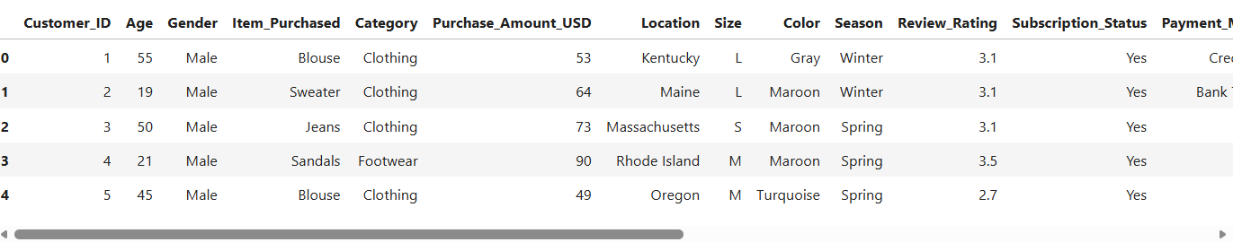
Dataset Description Source: Shopping Trends Database
Total Records: 3000
Total Attributes: 19
Type: Structured customer transaction data

Slide 4
Tools & Technologies Used
MySQL – Data storage
Python – Data analysis
Pandas & NumPy – Data processing
Scikit-learn – K-Means clustering
Jupyter Notebook – Implementation

Slide 5
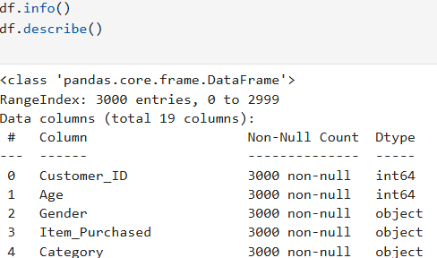
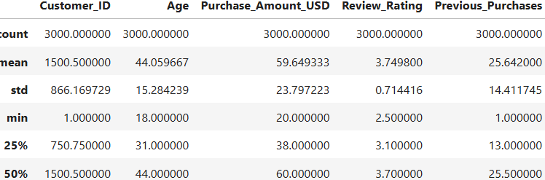
Data Collection, Understanding & Cleaning
Data loaded using Pandas
Dataset structure and attributes analyzed
Data checked for missing values and inconsistencies
Categorical data encoded

Slide 6
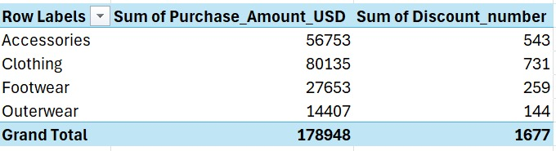
EDA – Discount Analysis
Exploratory Data Analysis performed
Category-wise discount impact analyzed

Slide 7
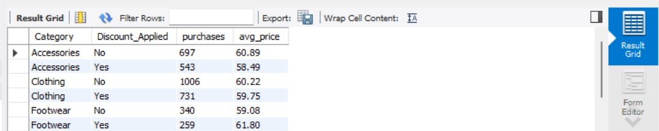
EDA – Discount Analysis
Findings: Compared to outwear, people tend to buy footwear in larger quantities.
If discounts are offered on these products, it is likely to increase purchases significantly.

Slide 8
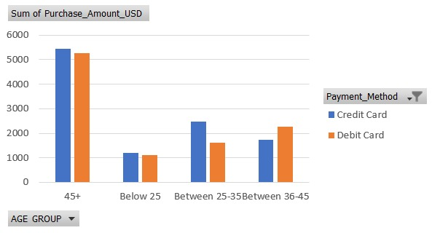
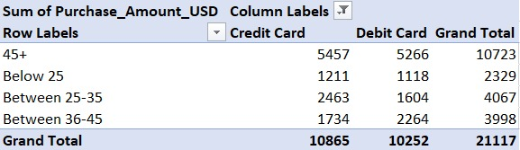
Card Spending by Age
Filtered credit and debit card transactions
Analyzed spending across age groups
Finding: Customers aged 45+ shows highest card spending

Slide 9
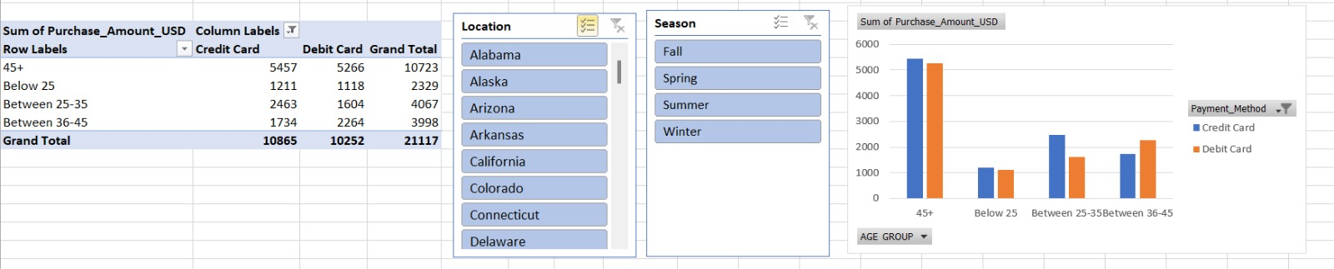
Season & Location Impact
Seasonal Impact:
Higher spending during Winter and Spring
Location Impact:
Urban locations show higher card usage

Slide 10
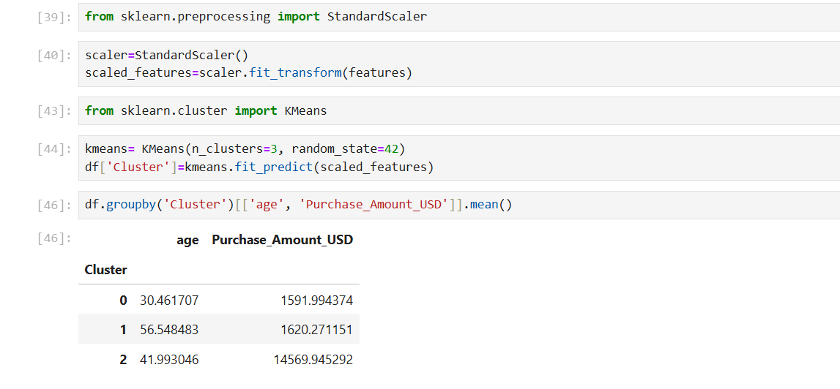
Feature Selection, Scaling & Clustering
Selected key features for segmentation
Data standardized using StandardScaler
K-Means clustering applied with K = 3

Slide 11
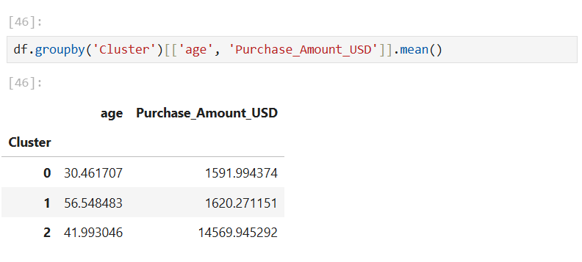
Customer Segments Identified
Cluster 0: High-Value Loyal Customers
Cluster 1: Discount-Sensitive Customers
Cluster 2: Low-Frequency Customers

Slide 12
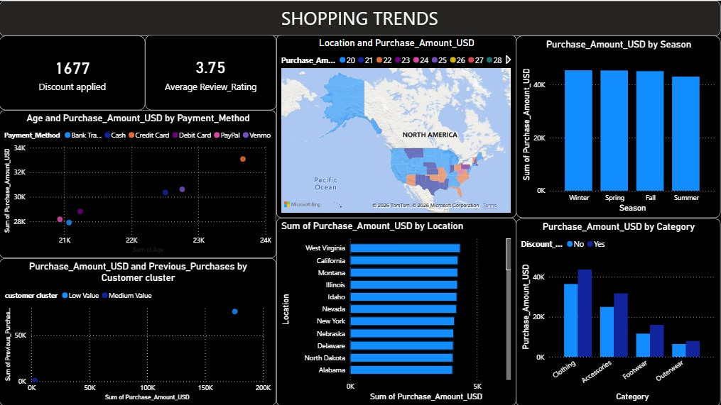

Slide 13
Targeted Marketing Strategies
High-Value: Loyalty programs, exclusive offers
Discount-Sensitive: Coupons, flash sales
Low-Frequency: Welcome offers, re-engagement campaigns

Slide 14
Conclusion
Discount and card spending analysis helped identify key customer purchasing patterns across categories, age, season, and location.
Customers were segmented into three distinct groups using clustering based on their shopping behavior.
The insights enable targeted marketing strategies that improve customer retention and overall business performance.

Slide 15
THANK YOU

